Slide 1


MCQ QUESTIONS

Slide 2
1) Calculate the total sales for orders shipped via "Standard Class" and having a "Profit" greater than 100.
(A) 611,658.554

Slide 3
2) Find the average discount applied to orders where the "Country" is "Los Angeles" and the "Category" is "Office Supplies", round upto 3 decimal places.
(B) 0.044

Slide 4
3) Identify the product with the highest total number of orders with the highest sales in terms of "Profit."
(A) Bush Somerset Collection Bookcase

Slide 5
4) Calculate the total number of orders with a "Return" status of "Yes" and a "Region" of "West."
D:186

Slide 6
5) Find the average quantity ordered for products in the "Central" region with a "Category" of "Office Supplies", round upto 2 decimals.
B) 3.80

Slide 7
6) Identify the customer with the highest total sales across all orders
(C) Sean Miller

Slide 8
7) Calculate the total number of orders with a "Ship Date" later than the "Order Date."
(D) 9475

Slide 9
8) Find the most popular "Product Category" for orders with a "Profit" less than 100
(B) Office Supplies

Slide 10
9) Identify the "Customer Name" with the most "Returned" orders.
(B) Mark Van Huff

Slide 11
10) Calculate the total "Profit" generated from orders placed in the "East" region with a "Discount" of 0.2.
(B) 21,122.8293

Slide 12
9. Dashboard Building: Build an interactive excel dashboard for the given dataset, find the guidelines to build the dashboard:
SCREESHOTS ATTACHED

Slide 13
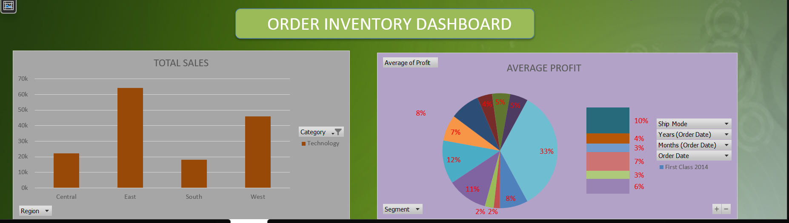

Slide 14
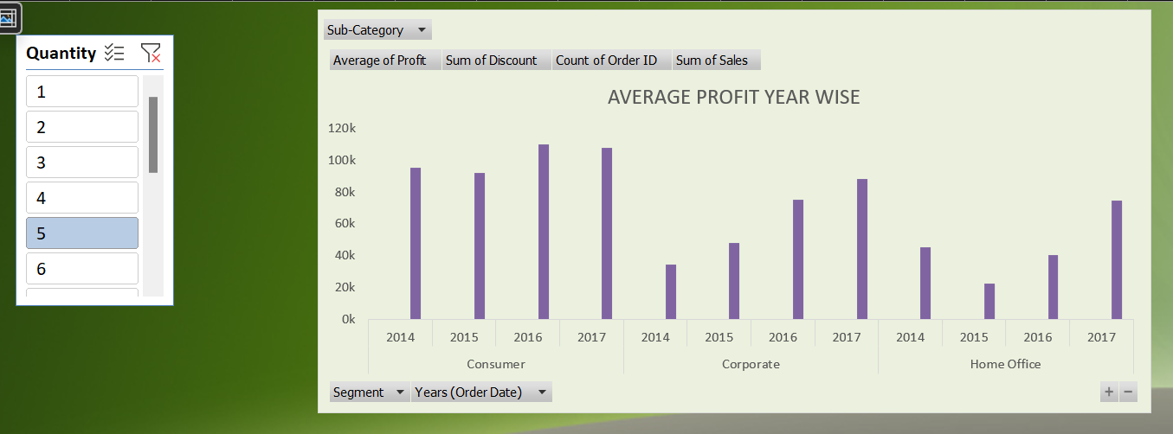

Slide 15
